Slide 1
Synchronization in Java

Slide 2
Synchronization in Java
Synchronization in Java is the capability to control the access of multiple threads to any shared resource.
Java Synchronization is better option where we want to allow only one thread to access the shared resource.

Slide 3
Why use Synchronization?
The synchronization is mainly used to
To prevent thread interference.
To prevent inconsistency problem.

Slide 4
Types of Synchronization
There are two types of synchronization
Process Synchronization
Thread Synchronization

Slide 5
Thread Synchronization
There are two types of thread synchronization mutual exclusive and inter-thread communication.
Mutual Exclusive
Synchronized method.
Synchronized block.
Static synchronization.
Cooperation (Inter-thread communication in java)

Slide 6
Mutual Exclusive
Mutual Exclusive helps keep threads from interfering with one another while sharing data. It can be achieved by using the following three ways:
By Using Synchronized Method
By Using Synchronized Block
By Using Static Synchronization

Slide 7
Concept of Lock in Java
Synchronization is built around an internal entity known as the lock or monitor. Every object has a lock associated with it.
By convention, a thread that needs consistent access to an object's fields has to acquire the object's lock before accessing them, and then release the lock when it's done with them.
From Java 5 the package java.util.concurrent.locks contains several lock implementations.

Slide 8
Understanding the problem without Synchronization

Slide 9
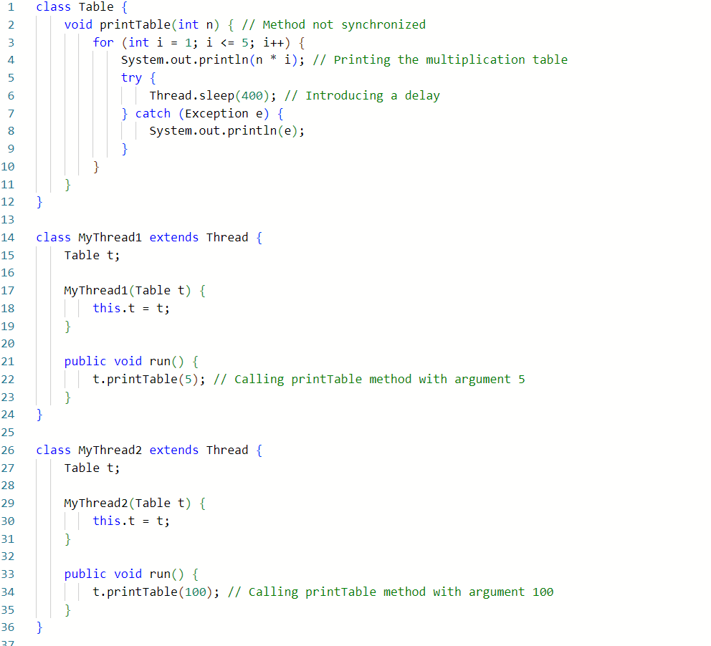

Slide 10
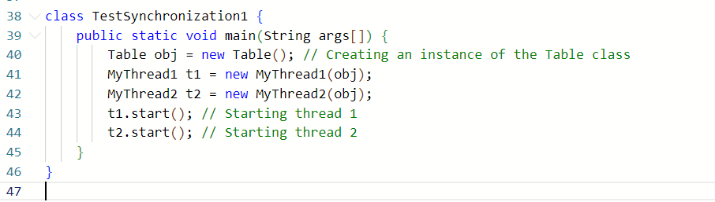
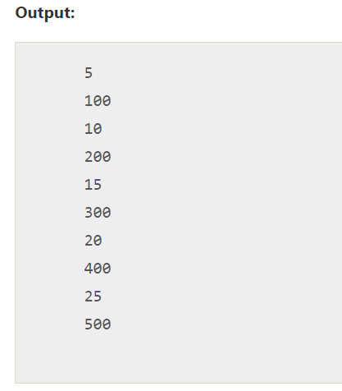
In this example, there is no synchronization, so output is inconsistent.

Slide 11
Java Synchronized Method
If you declare any method as synchronized, it is known as synchronized method.
Synchronized method is used to lock an object for any shared resource.
When a thread invokes a synchronized method, it automatically acquires the lock for that object and releases it when the thread completes its task.

Slide 12
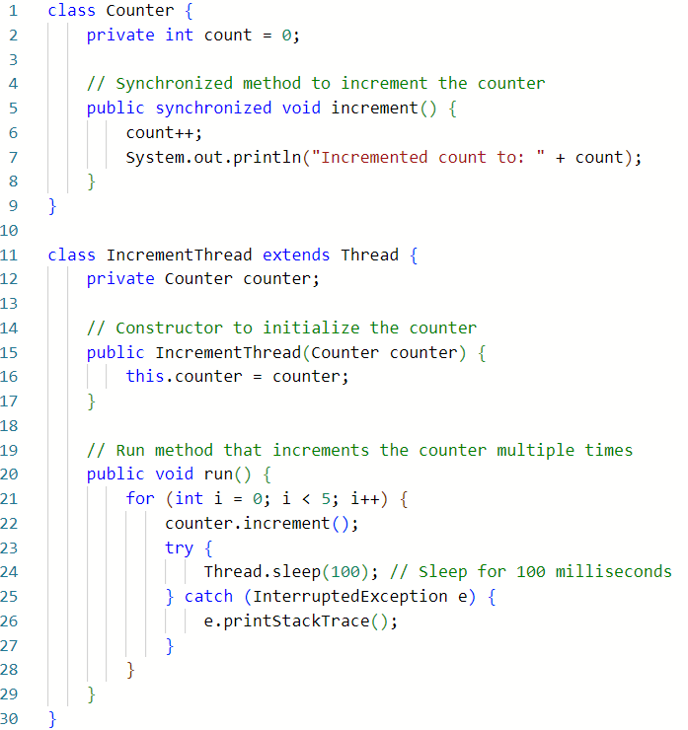
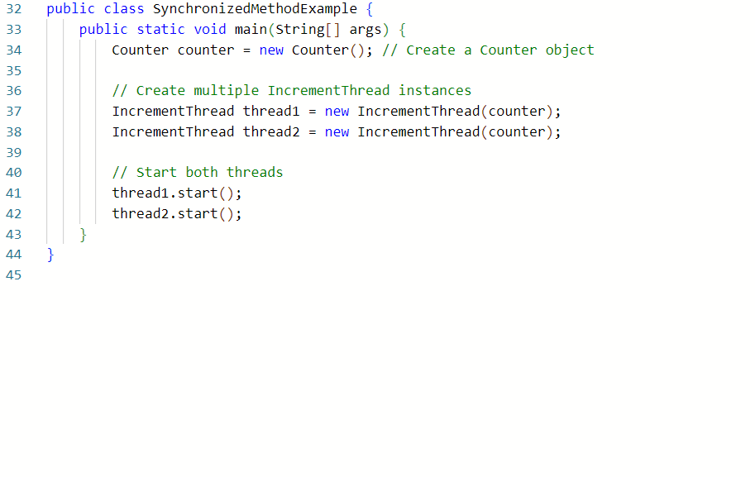
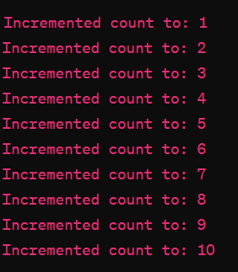

Slide 13
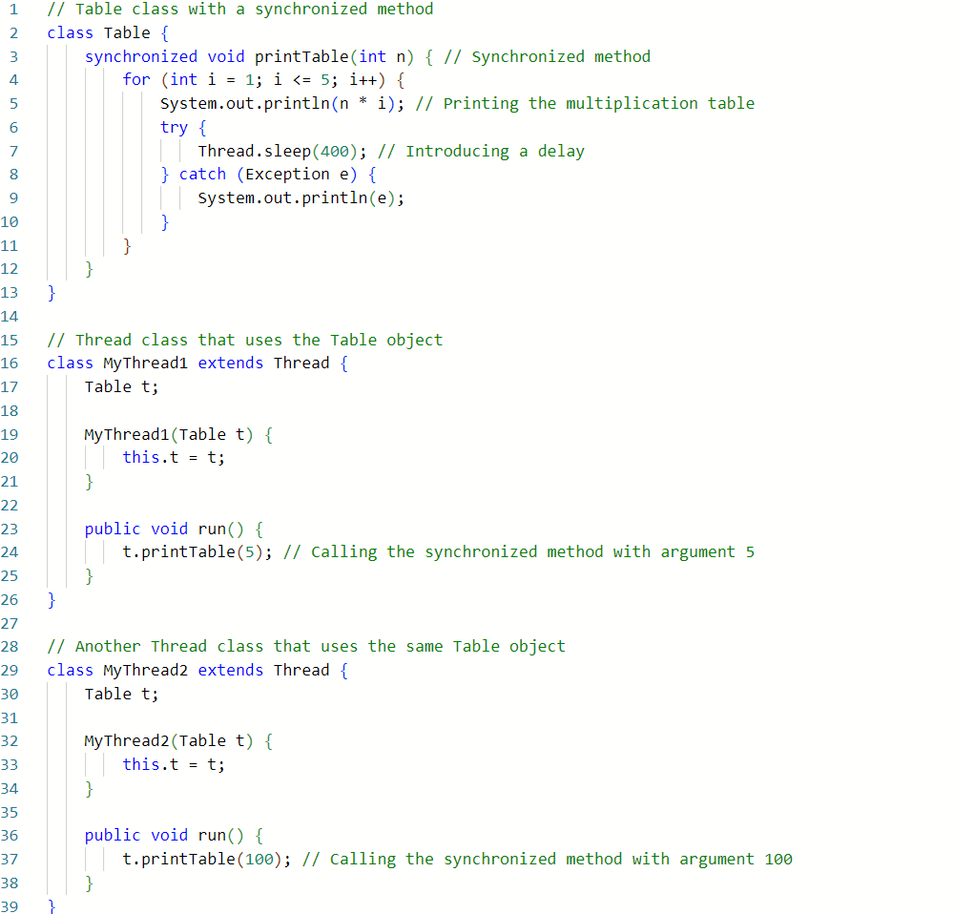

Slide 14
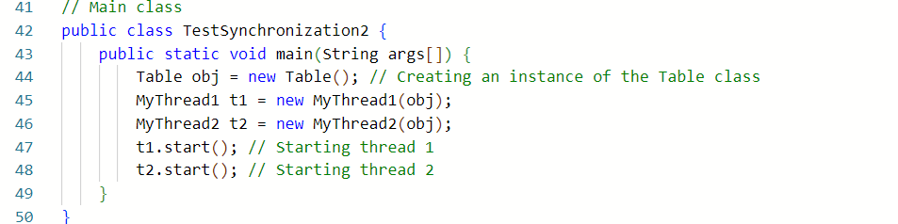


Slide 15
Synchronized Block in Java
Synchronized block can be used to perform synchronization on any specific resource of the method.
Suppose we have 50 lines of code in our method, but we want to synchronize only 5 lines, in such cases, we can use synchronized block.
If we put all the codes of the method in the synchronized block, it will work same as the synchronized method.

Slide 16
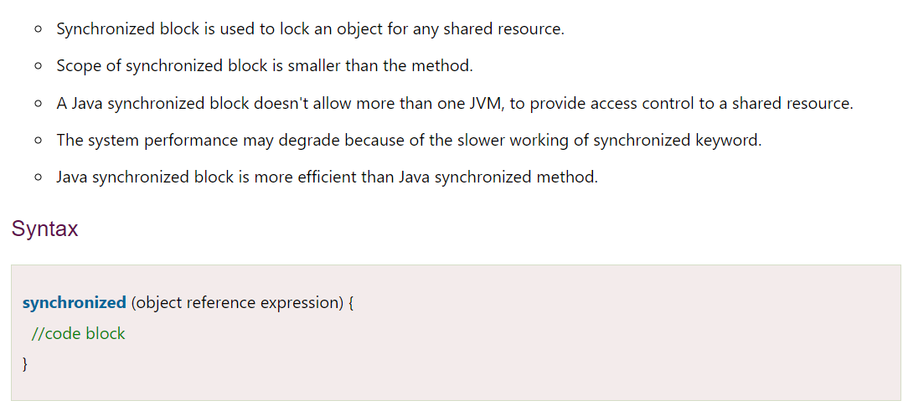
Points to Remember

Slide 17
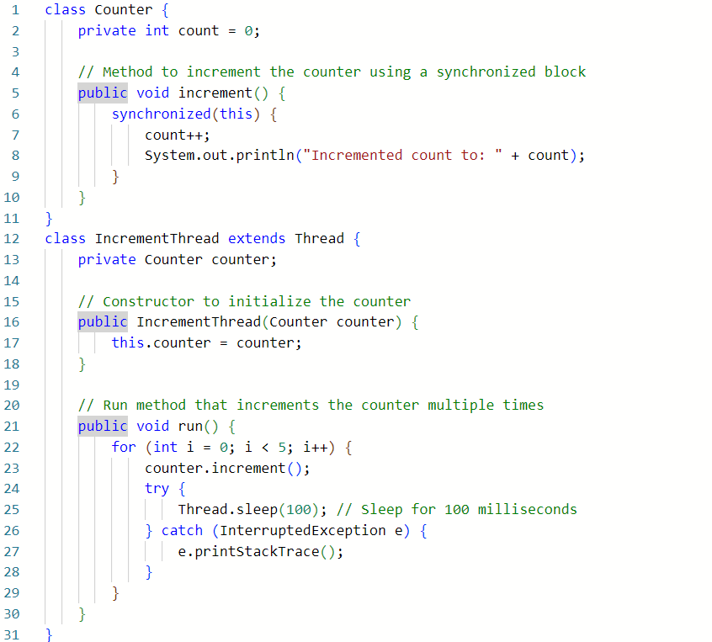
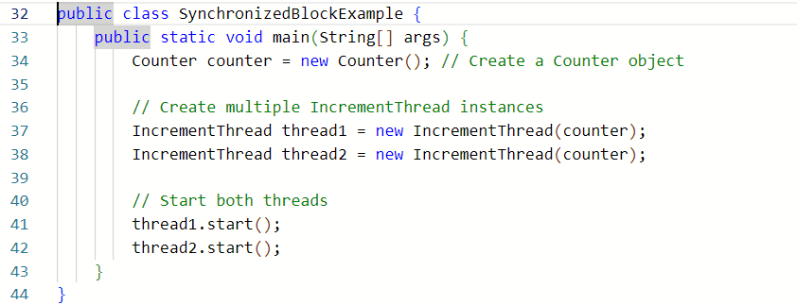

Slide 18
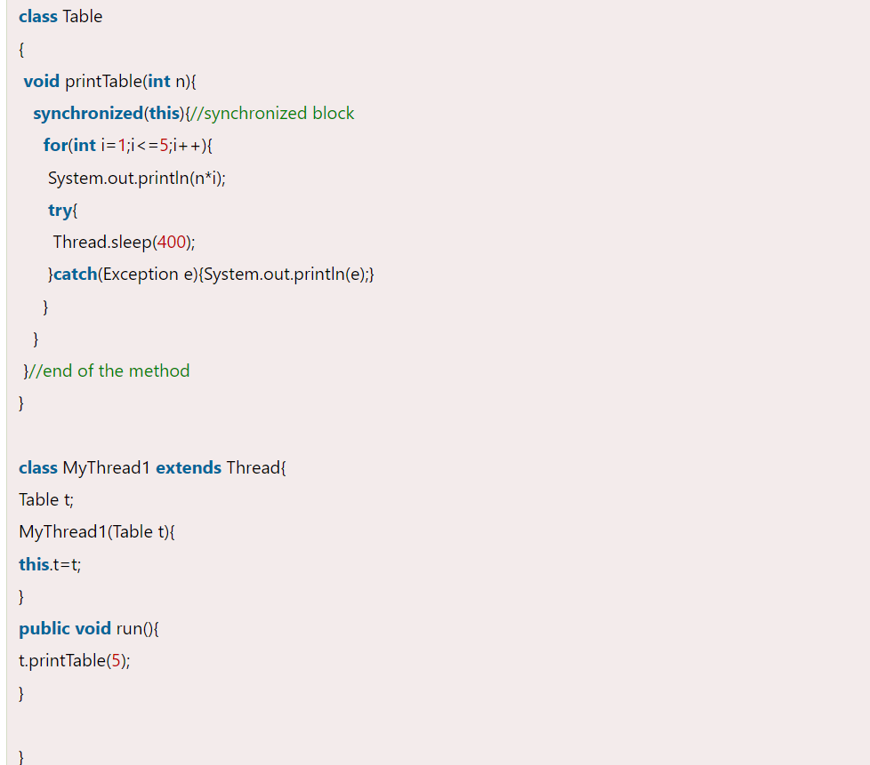
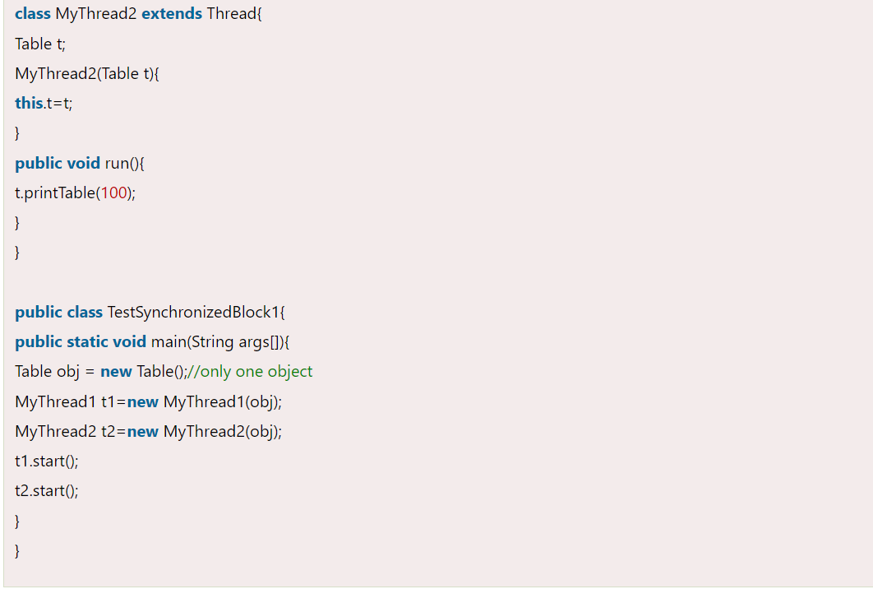
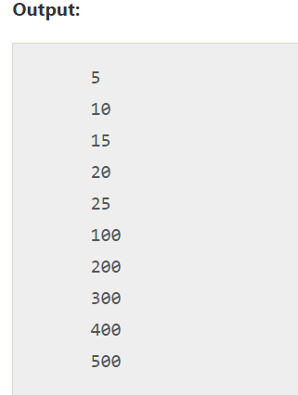

Slide 19
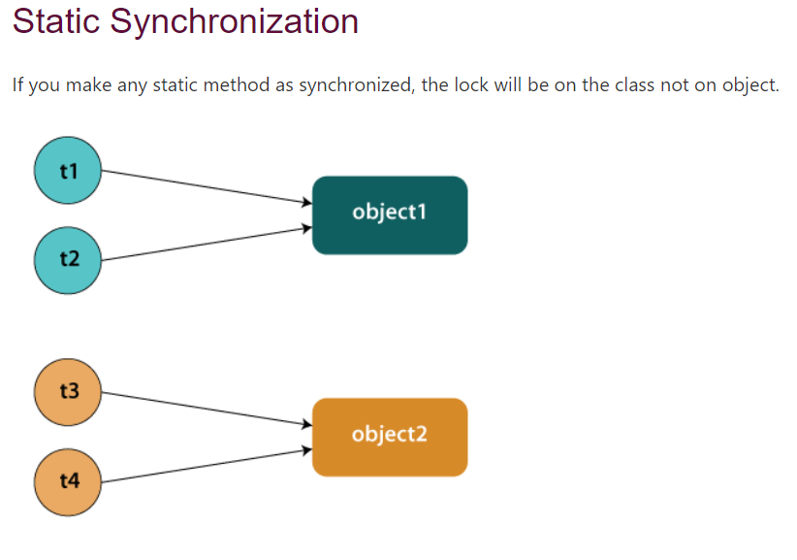

Slide 20
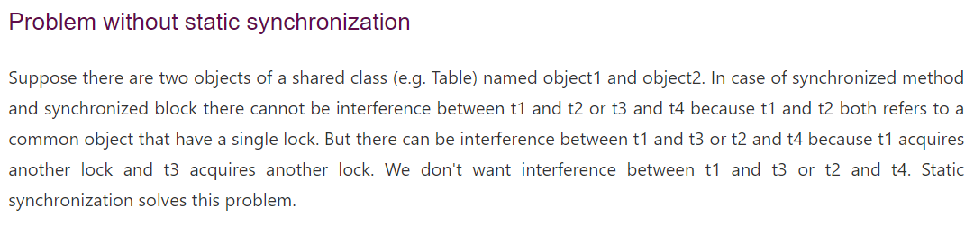

Slide 21
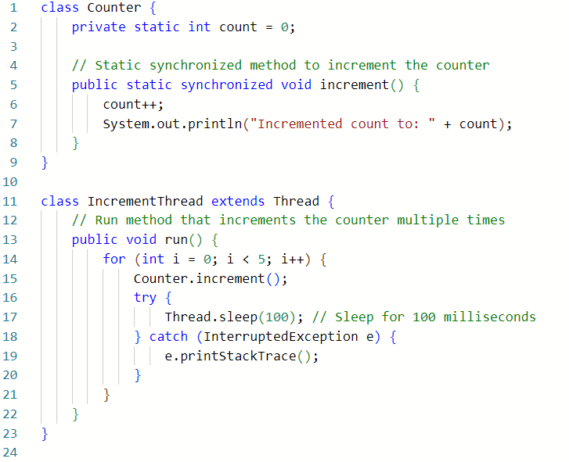
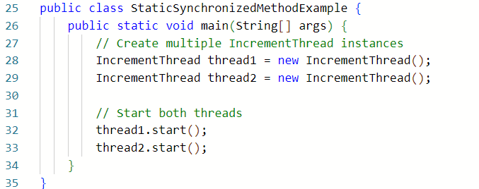

Slide 22
